Slide 1
Introduction to Environments
COMP41400: Multi-Agent Systems
Lecturer: Rem Collier
Email: rem.collier@ucd.ie

Slide 2
Introduction
Last week, we programmed agents as mental entities:
They manipulated their beliefs in a way that allowed them to simulate, for example, controlling a light.
In practice, it is expected that agents will operate as embodied entities:
They will manipulate entities that exist within some real/virtual domain.
How can we achieve this?

Slide 3
Agentification
In the beginning, everything was an agent…
Agt 3
Agt 1
Agt 2

Slide 4
Agentification
In the beginning, everything was an agent…
But then somebody wanted them to interact with an existing non-agent-based system?
Agt 3
?
Non-Agent
System
Agt 1
Agt 2

Slide 5
Agentification
In the beginning, everything was an agent…
Given the power of agents, it was decided that they should agentify it!
Agt 3
?
Non-Agent
System
Agt 1
Agt 2

Slide 6
Agentification
In the beginning, everything was an agent…
Given the power of agents, it was decided that they should agentify it!
Develop a custom agent architecture (Shoham called it an agentifier).
Agt 3
Non-Agent
System
Agt 1
Agt S
Agt 2

Slide 7
Agentification
In the beginning, everything was an agent…
Given the power of agents, it was decided that they should agentify it!
Develop a custom agent architecture (Shoham called it an agentifier).
Integrate the new piece of software/hardware into this architecture.
Agt 3
Non-Agent
System
Agt 1
Agt S
Agt 2

Slide 8
Agentification
In the beginning, everything was an agent…
Given the power of agents, it was decided that they should agentify it!
Develop a custom agent architecture (Shoham called it an agentifier).
Integrate the new piece of software/hardware into this architecture.
All interaction with that software/hardware is via the associated agent.
Agt 3
Non-Agent
System
Agt 1
Agt S
Agt 2

Slide 9
Beyond Agentification…

Slide 10
Beyond Agentification…
Alternatively, we can introduce the idea of an environment:
This is the part of the system that defines possible interactions between the agents and the world they inhabit.
Traditionally, the environment has been viewed as:
Something outside/unimportant to MAS design and implementation
The context where agent activities take place…
Where the drudgery happens…
Traditionally, >50% of the MAS development effort is spent working out how to link the agent to the environment!
Transforming raw data into beliefs (implementing the domain model)
Mapping action identifiers to (potentially complex) behaviours (defining how the agent can affect its environment)

Slide 11
Agents & Environments
The environment is the workspace of the agents.
Here, agents sense the state of the world (building the domain model)
It is also the place that they act (defining how they can affect the world)
Historically, agents used sensors and actuators to directly affect their environment.
Many bespoke sensing solutions developed
Often specific to each agent toolkit
Most based on a class with a sense() and act() method.
Implementations are rarely reusable across applications (even with the same toolkit)

Slide 12
Agents & Environments
public class SwitchEnvironment extends Environment {
private Boolean switch = false;
public boolean act(String name, Action action) {
if (action.identifier().equals(“flip”)) {
switch = !switch;
return true;
}
return false;
}
public Belief[] sense(String name) {
List<Belief> beliefs = new LinkedList<>();
if (name.equals(“agent1”)) {
beliefs.add(new Belief(“switch”, ...));
}
return beliefs.toArray(new Belief[beliefs.size()]);
}
}

Slide 13
Bespoke Environments: Environments in ASTRA

Slide 14
Environments in ASTRA
ASTRA supports the creation of environments through modules
Modules are Java classes that support sensing and acting through the @SENSOR and @ACTION annotations.
Sensing requires understanding of what has changed in the world.
Intimately linked to belief revision.
Sensors must remove beliefs that are no longer true and insert new beliefs as the world changes.
Invariably, this requires polling…
Where the agent has complete control of the environment, belief update can be done through action alone…

Slide 15
No Sensing Switch
public class Switch extends Module {
private boolean on = false;
private Predicate belief =
new Predicate("switch", new Term[] {Primitive.newPrimitive("off")});
@Override
public void setAgent(Agent agent) {
super.setAgent(agent);
agent.beliefs().addBelief(belief);
}
@ACTION
public boolean flip() {
on = !on;
agent.beliefs().dropBelief(belief);
agent.beliefs().addBelief(
belief = new Predicate("switch",
new Term[] {Primitive.newPrimitive(on?"on":"off")})
);
return true;
}
}

Slide 16
No Sensing Switch
agent NoSensingSwitch {
module Console C;
module Switch S;
types main {
formula switch(string);
}
rule +!main(list args) {
S.flip();
}
rule +switch(string S) {
C.println("switch is in state: " +S);
}
}

Slide 17
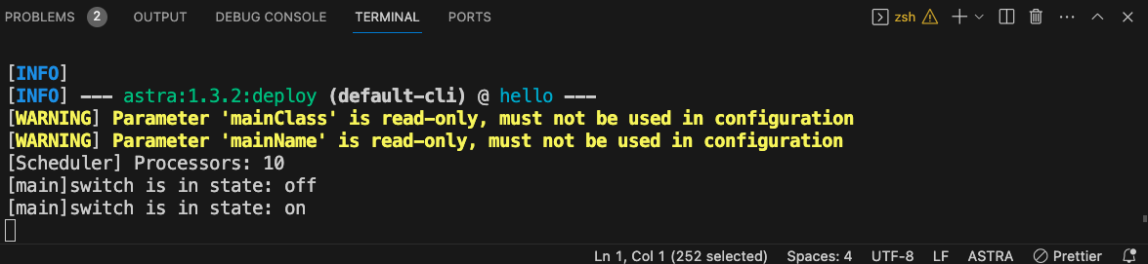
No Sensing Switch
agent NoSensingSwitch {
module Console C;
module Switch S;
types main {
formula switch(string);
}
rule +!main(list args) {
S.flip();
}
rule +switch(string S) {
C.println("switch is in state: " +S);
}
}

Slide 18
Sensing Switch
public class Switch extends Module {
private boolean on = false;
@ACTION
public boolean flip() {
on = !on; return true;
}
private Predicate belief; private boolean lastState = true;
@SENSOR
public void sense() {
if (lastState == on) return;
if (belief != null) agent.beliefs().dropBelief(belief);
agent.beliefs().addBelief(
belief = new Predicate("switch",
new Term[] {Primitive.newPrimitive(on?"on":"off")})
);
lastState = on;
}
}

Slide 19
Sensing Switch
agent SensingSwitch {
module Console C;
module Switch S;
types main {
formula switch(string);
}
rule +!main(list args) {
S.flip();
}
rule +switch(string S) {
C.println("switch is in state: " +S);
}
}

Slide 20
Back to our LightSwitch…

Slide 21
Add a Light Module…
public class Light extends Module {
private boolean on = false;
private Predicate belief =
new Predicate(”light", new Term[] {Primitive.newPrimitive("off")});
@Override
public void setAgent(Agent agent) {
super.setAgent(agent);
agent.beliefs().addBelief(belief);
}
@ACTION
public boolean flip() {
on = !on;
agent.beliefs().dropBelief(belief);
agent.beliefs().addBelief(
belief = new Predicate(”light",
new Term[] {Primitive.newPrimitive(on?"on":"off")})
);
return true;
}
}

Slide 22
And Our LightSwitch Code…
agent Main {
module Console C;
module Switch S;
module Light L;
types main {
formula switch(string);
formula light(string);
formula transition(string, string);
}
initial transition("off", "on"), transition("on", "off");
rule +!main(list args) { S.flip(); }
rule +switch(string S) { !light(S); }
rule +!light(string S) : transition(string R, S) & light(R) { L.flip(); }
rule +!light(string S) {}
rule +light(string S) { C.println("The light is: " + S); }
}

Slide 23
Astra Tower Example
To see a more complex example, you can look at the ASTRA tower world implementation, which can be found here:
https://gitlab.com/astra-language/examples/astra-guides/-/tree/master/astra-tower

Slide 24
Beyond Bespoke Environments

Slide 25
Beyond Bespoke Environments
Circa 2007 – Environments as 1st class abstractions
Acceptance of the need to standardise how agents interact with the environment.
Recognised need for cross-platform solutions…
Multiple approaches: EIS, CArtAgO, ABStractme,…
The environment is a first-class abstraction that provides the surrounding conditions for agents to exist and that mediates both the interaction among agents and the access to resources
[Weyns, Omicini, Odell, 2007]

Slide 26
Environment Features
The environment provides the surrounding conditions for agents to exist
On their own, agents are just loci of control
It is the glue that connects agents into a working system….
The environment mediates interaction between agents and access to resources
The environment is an active participant in the MAS
It provides a medium for sharing information and mediating coordination among agent.
The environment both enables and constraints interaction
As such the environment provides a design space that can be exploited by the designer…

Slide 27
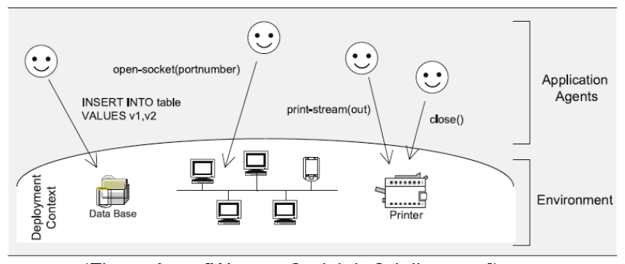
Environment Support Levels
Basic: The environment enables agents to access the deployment context.
i.e. hardware and software and external resources with which the MAS interacts.

Slide 28
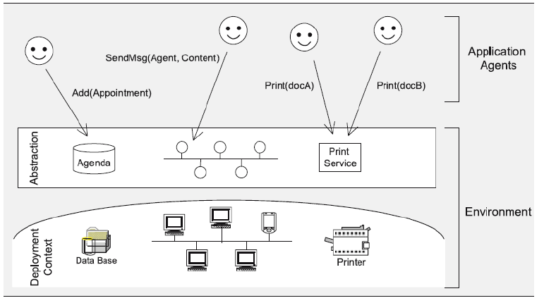
Environment Support Levels
Abstraction: Bridges the conceptual gap between the agent abstraction and low-level details of the deployment context.
Shields low-level details of deployment context

Slide 29
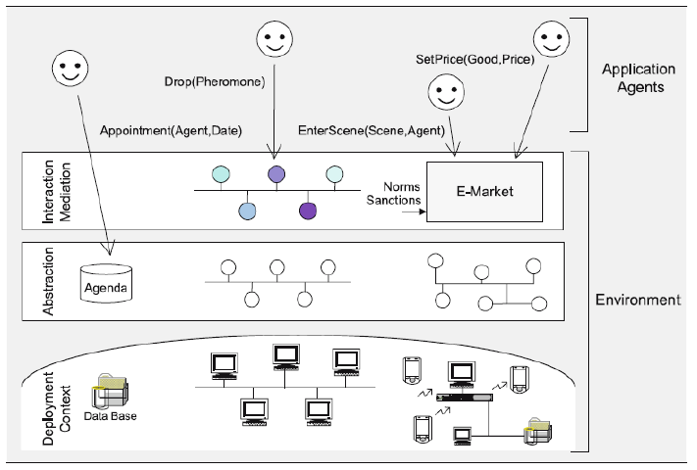
Environment Support Levels
Interaction-Mediation: Regulation of access to shared resources / mediation of interaction between agents.

Slide 30
Environment Support

